Slide 1

EV POPULATIONS
BY
AKSHAY MANOJ

Slide 2

INTRODUCTION:
The adoption of Ev’s has emerged as a significant step toward achieving sustainability and reducing CO2 emissions in the transportation sector. The dataset captures the growth and distribution of EV’s across the United States. It also highlights geographic distribution patterns, offering valuable insights into regional EV adoption trends and infrastructure readiness. It provides insights into the shift toward sustainable transportation and the role of clean energy incentives in driving EV adoption.

Slide 3

FEATURES:
Country
City
State
Make
Model
Electric Vehicle Type
Clean Alternative Fuel
Vehicle Eligibility
Electric Range
Base MSRP
Census_Tract_2020

Slide 4
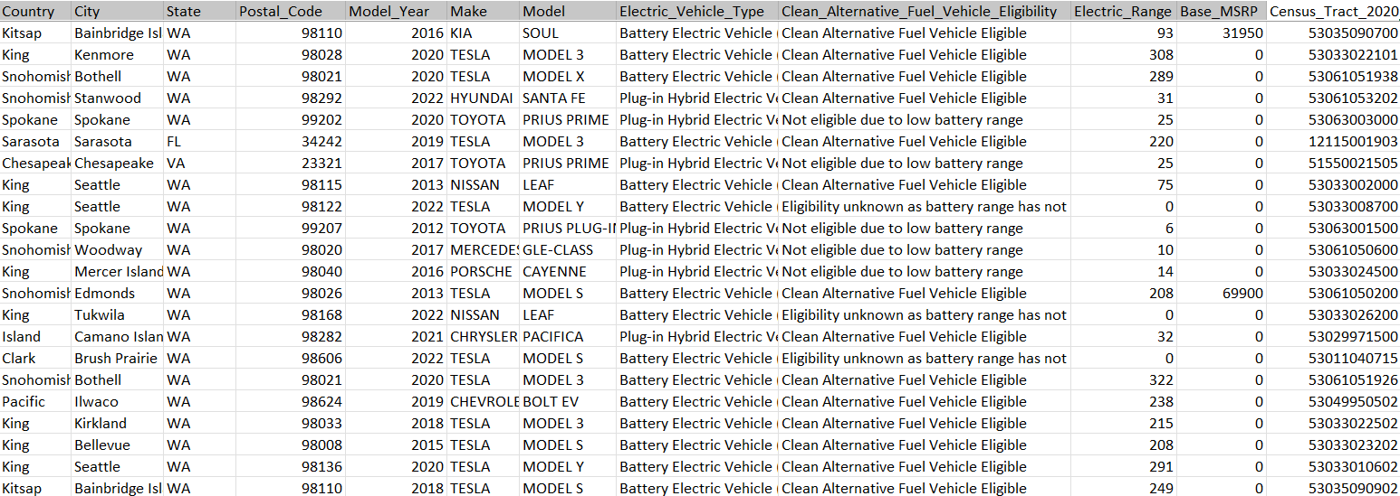
DATASET:

Slide 5
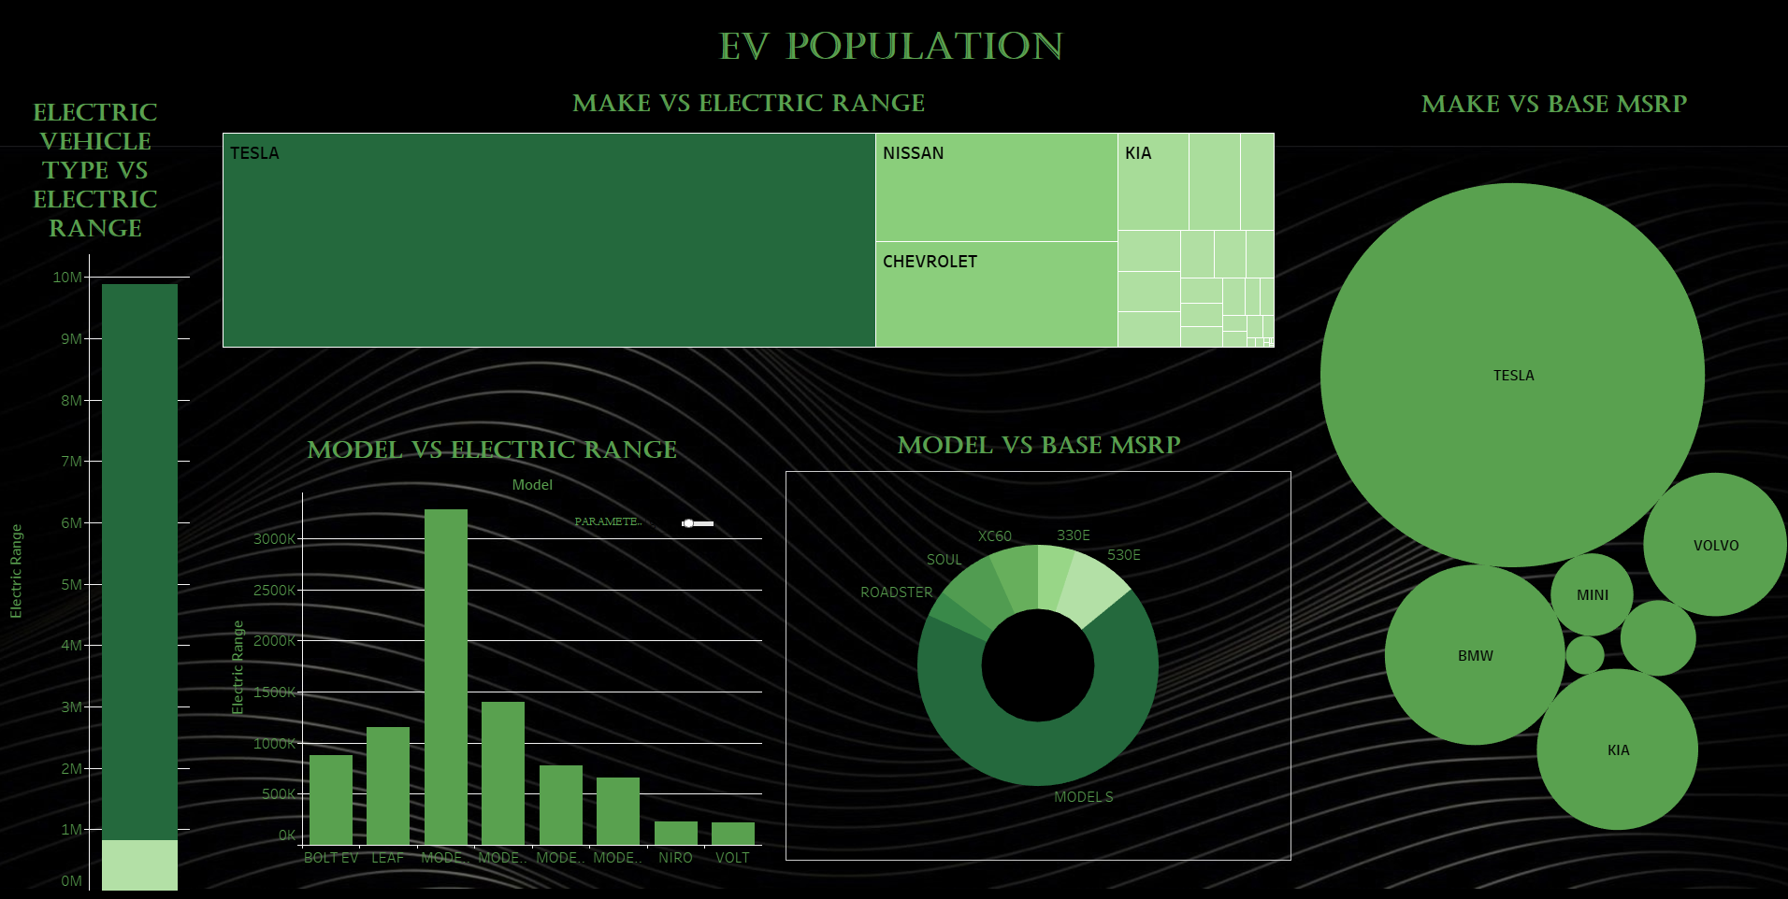
DASHBOARD:

Slide 6

FINDINGS:
ELECTRIC VEHICLE TYPE VS ELECTRIC RANGE
Battery Electric Vehicle (BEV) out runs the
Hybrids versions
MAKE VS ELECTRIC RANGE
TOP – TESLA
LOW – TH!NK
MAKE VS BASE MSRP
TOP – TESLA,BMW
LOW – CADILLAC

Slide 7
FINDINGS:
MODEL VS ELECTRIC RANGE
TOP – TESLA(MODEL 3, MODEL-S)
LOW – EDV,C40
MODEL VS BASE MSRP
TOP – TESLA(MODEL-S)
LOW – ROADSTER

Slide 8

APPLICATION:
Policy Development:
Analyze trends in clean fuel vehicle eligibility to refine government incentives for EV adoption.
Market Analysis for Manufacturers:
Identify consumer preferences for specific makes, models, and electric ranges to design competitive and desirable EVs.
Infrastructure Planning:
Evaluate the geographic spread of EVs to strategically place charging stations where they are most needed.

Slide 9
APPLICATION:
Environmental Impact Assessment:
Quantify the potential reduction in greenhouse gas emissions resulting from the current and projected EV population.
Automotive Industry Insights:
Study preferences for vehicle models, manufacturers, and electric ranges to understand market dynamics.
Energy Sector Optimization:
Use EV distribution data to forecast and balance renewable energy contributions to the grid.

Slide 10

Conclusion:
The dataset reveals significant progress in EV adoption, with trends in vehicle types and regional preferences. It highlights the importance of clean energy incentives and serves as a valuable resource for tracking the industry's evolution and guiding future strategies for sustainable transportation.

Slide 11


